Slide 1
Manufacturing-X and AutomationML
Potentials and Pitfalls
September 23rd 2026
Pforzheim, Germany

Slide 2

Factory-X Kernel
Systemic approach to „Manufacturing-X“
Including SME and additional sectors
Transfer-X
Transfer project (tbc)
Manufacturing-X
Factory-X
Process-X
Robot-X
Semicon-ductor-X
Aerospace-X
Energy Data-X, …
International Manufactu-ring-X
Research and development: Industry Use Cases
Common Base
Shared Services
Shared technical base layer
Regulatory framework and standards

Slide 3





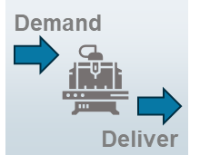
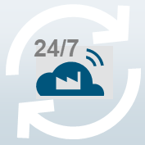




11 Use Cases of Factory-X
11 Use Cases for horizontal and vertical data transfer
Integrated Toolchains and Collaborative Engineering
Information Update and Change Service
Collaborative Information Logistics
Condition Monitoring led Services
Modular Production
Manufacturing as a Service – On Demand Manufacturing
Autonomous Operation-as-a-Service
Traceability
Energy-Consumption and Load
Management
Carbon Footprint Management
Circular Economy
Factory-X Kernel & Basis Services

Slide 4

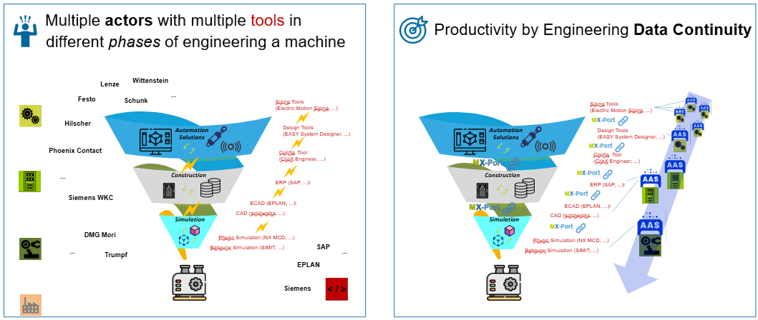
The Engineering Use Case in Factory-X
Integrated Toolchains and Collaborative Engineering
From Challenges …
…to Solutions.

Slide 5



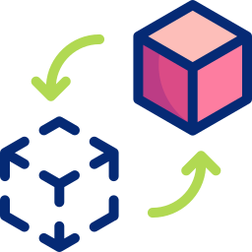


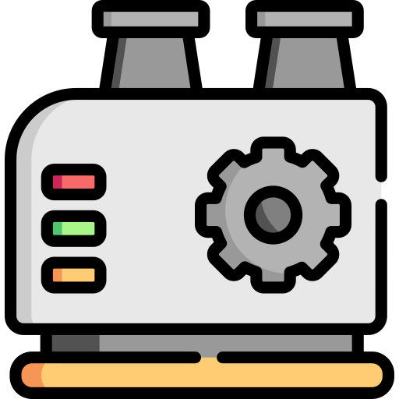
Integrated Toolchains & Collaborative Engineering
Productivity by Engineering Data Continuity
Components
Increase productivity of engineering processes
Facilitate & accelerate collaborative engineering
Integrated Toolchains for digital engineering from virtual solution finding and configuration to simulation
Configuration
Specification
Integration
Simulation
Data continuity along integrated vendor-independent toolchains based on common standards
Collaborative use of engineering data based on a trusted framework (MX Port)
Digital twins for simulating and optimizing production processes and systems during life cycle

Slide 6
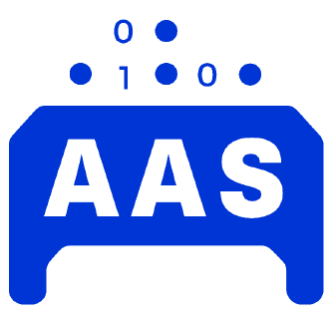
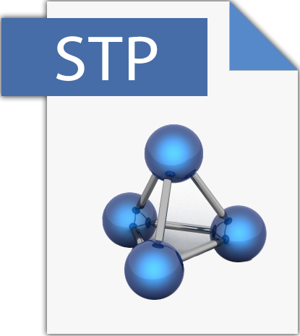
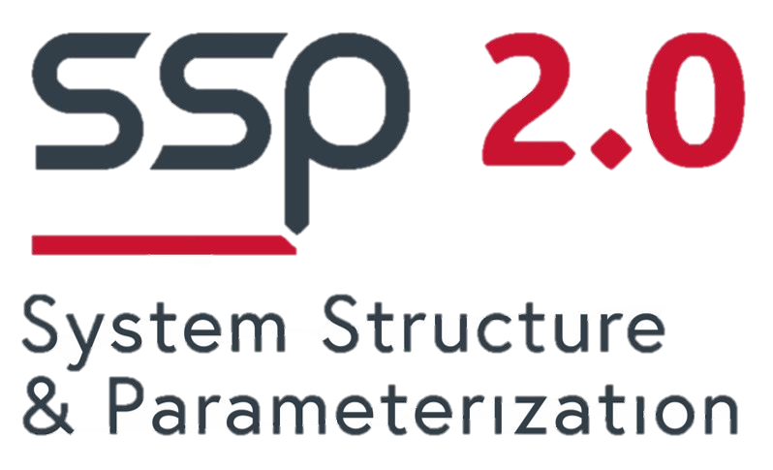
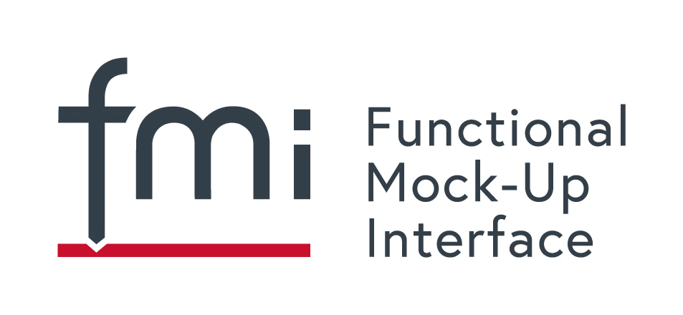

Workstream 3 (SIM)
Focused Usage View and Selected Technologies
Component Supplier
Machine Builder
provides component
+
+
+
…
+
Digital component
Simulation Model
Simulation model broker
Technical Data
Engineering
VC / Simulation
3D model?
CAD
SolidWorks
Mechanical Engineering
Physics Simulation
(NX MCD)
…
Solidworks Connector
NX MCD Connector
VC Data Integrator
*1
VC Simulation Model Generator
VC
Simulation
Model
ECAD
EPLAN
Automation Engineering
SIMIT Connector
Behavior Simulation
(SIMIT)
EPLAN Connector

Slide 7
The role of AutomationML in engineering
AutomationML solves issues prevalent in data space setups
  Common semantic model (not RDF/ontology modeling necessary)
  Well defined and machine-readable data encoding
  Compatibility to AAS as adressing scheme defined
Currently, data space projects are discussing the right technical depth
  AAS based versus Eclipse Dataspace Connector based solutions
  Payload unification is use case dependent
  Engineering still in the phase of stabilising

Slide 8
The future of industrial engineering?
Engineering chains are due for a change
The advent of industrial AI is prone to bring changes
Procurement might be driven by AI solutin finding
For AI agents, structured data is a very relevant cost saver
Having AutomationML device models might become even more relevant the more traction data spaces and industrial AI get

Slide 9
The future of industrial engineering?
Requirements
Factory
Owner
CAD Model
CAD Software
Parts + CAD + ECAD + PLC
Running Machine
CAD + ECAD
Model
CAD+ECAD+PLC Program
Parts
BOM
ECAD Software
Commissioning
PLC Programming
Purchasing

Slide 10
The future of industrial engineering?
Requirements
Factory
Owner
Requirements
Agentic
AI
CAD + ECAD + PLC
CAD Model
Humanoid
Workforce
CAD Software
CAD + ECAD
Model
CAD+ECAD+PLC Program
Parts
BOM
Running Machine
ECAD Software
PLC Programming
Purchasing
Commissioning

Slide 11

Discussion

